Slide 1

A Data-Driven Approach to Exploring and Standardizing Inpatient Diabetes Care across a Healthcare System
Shanza Ashraf
Data Analyst
Emory Healthcare | Office of Quality
emoryhealthcare.org

Slide 2

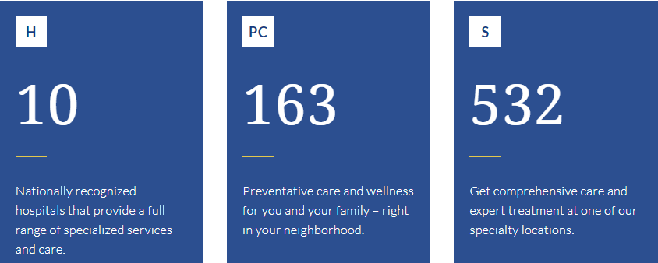

Emory Healthcare
Most comprehensive academic health system in Georgia
Affiliated with Emory University
emoryhealthcare.org
Notes:
Emory Healthcare is the most comprehensive academic health system in Georgia and the only one with three Magnet®-designated hospitals, one of which (Emory Saint Joseph's) recently earned an unprecedented sixth consecutive Magnet designation.
Continuously top ranked in US News & World Report’s Best Hospitals

Slide 3
Outline
Background
Diabetes
Our Data Structure
Quality Improvement (QI)
Current Diabetes-Related Projects using R
QI Case Study: Reducing Correctional Insulin (Sliding Scale Insulin) Administration Errors
emoryhealthcare.org
Notes:
Global burden: there were an estimated 422 million (~9%) adults worldwide living with diabetes in 2014.
At Emory Healthcare, between 20-30% of inpatient admissions each month are diabetics requiring comprehensive care for both the chronic disease and any acute problem resulting in the hospitalization
Goal is to understand and improve care now to reduce burden later

Slide 4
Background: Diabetes mellitus
A chronic disease in which the body does not produce enough insulin or cannot effectively use the insulin it produces
Insulin is a vital hormone that regulates blood sugar (glucose)
Diabetes is a large driver of quality-related metrics in inpatient settings
9%
Global burden of diabetes
20-30% EHC Inpatient admissions are diabetics
Higher in-hospital mortality
Higher readmission rates
More high-risk comorbidities
emoryhealthcare.org
Notes:
Global burden: there were an estimated 422 million (~9%) adults worldwide living with diabetes in 2014.
At Emory Healthcare, between 20-30% of inpatient admissions each month are diabetics requiring comprehensive care for both the chronic disease and any acute problem resulting in the hospitalization
Goal is to understand and improve care now to reduce burden later

Slide 5
Background: Our Data Approach
Before
Data Silos
Information Silos
Isolated QI Projects
Pockets of success
emoryhealthcare.org
Notes:
System-level reporting for our 4 main hospitals

Slide 6
Background: Our Data Approach
Before
Data Silos
Information Silos
Isolated QI Projects
Pockets of success
Goal
Integrated Data, Automated Reporting
Holistic understanding
System-wide interventions
Standardized, high-quality patient care
emoryhealthcare.org
Notes:
System-level reporting for our 4 main hospitals

Slide 7
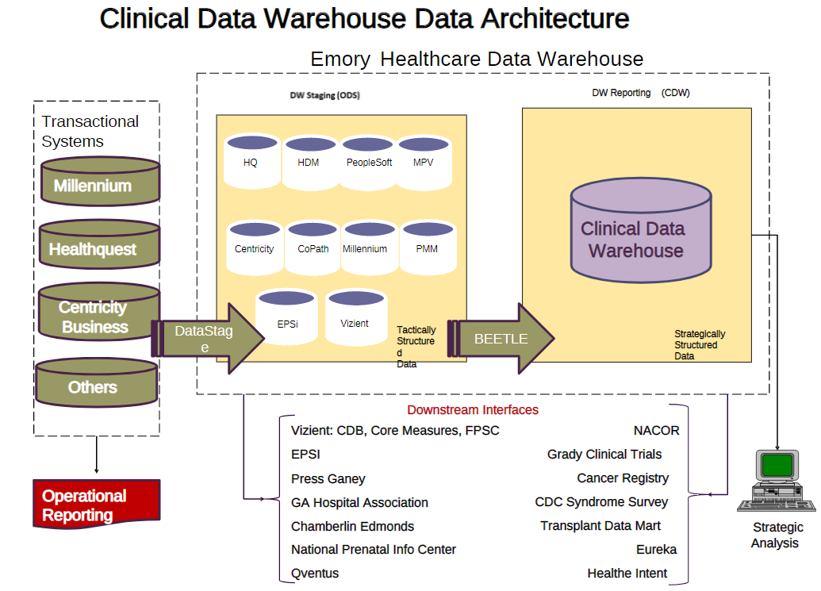

Notes:
Data Silos by nature of CDW

Slide 8
Quality Improvement (QI)
In healthcare, it is the framework we use to systematically and continuously improve the ways in which we provide care to patients
Evidence-based
Data-driven
Interdisciplinary
Establishes or improves standard of care
Meet/exceed regulatory requirements
Donabedian model
Structures
Infrastructure
Demographics
Equipment
Education
Staff
Processes
Diagnosis
Treatment
Interaction
Behaviors
Outcomes
Mortality
Morbidity
Readmission
Quality of life
Pt. satisfaction
emoryhealthcare.org
Notes:
Global burden: there were an estimated 422 million (~9%) adults worldwide living with diabetes in 2014.
At Emory Healthcare, between 20-30% of inpatient admissions each month are diabetics requiring comprehensive care for both the chronic disease and any acute problem resulting in the hospitalization
Goal is to understand and improve care now to reduce burden later

Slide 9
Quality Improvement (QI)
In healthcare, it is the framework we use to systematically and continuously improve the ways in which we provide care to patients
Evidence-based
Data-driven
Interdisciplinary
Establishes or improves standard of care
Meet/exceed regulatory requirements
Donabedian model
Structures
Infrastructure
Demographics
Equipment
Education
Staff
Processes
Diagnosis
Treatment
Interaction
Behaviors
Outcomes
Mortality
Morbidity
Readmission
Quality of life
Pt. satisfaction
emoryhealthcare.org
Notes:
Global burden: there were an estimated 422 million (~9%) adults worldwide living with diabetes in 2014.
At Emory Healthcare, between 20-30% of inpatient admissions each month are diabetics requiring comprehensive care for both the chronic disease and any acute problem resulting in the hospitalization
Goal is to understand and improve care now to reduce burden later

Slide 10
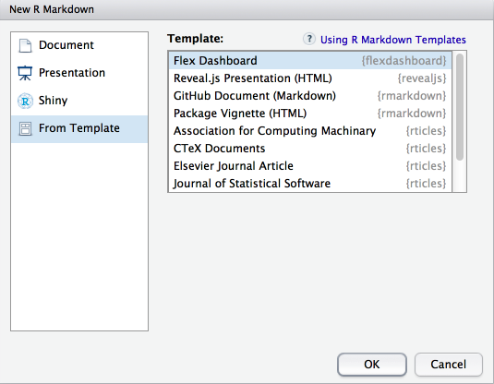
Current Projects
An all-inclusive dashboard reviewing:
Demographics of our diabetic admissions
Outcome metrics: mortality, comorbidities, readmissions
Glucometrics (glycemic control)
Medication regimens
Medication errors (correctional insulin)
Inpatient diabetes education
Order set use
Provider ordering practices
Hospital Medicine/Endocrinology Consults
Outpatient referrals
Automated weekly/monthly reports to
physicians, nurses, pharmacists, diabetes
educators, leaders
emoryhealthcare.org
Notes:
Global burden: there were an estimated 422 million (~9%) adults worldwide living with diabetes in 2014.
At Emory Healthcare, between 20-30% of inpatient admissions each month are diabetics requiring comprehensive care for both the chronic disease and any acute problem resulting in the hospitalization
Goal is to understand and improve care now to reduce burden later

Slide 11
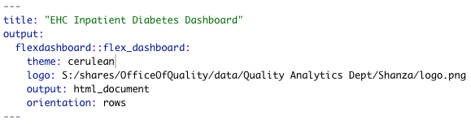
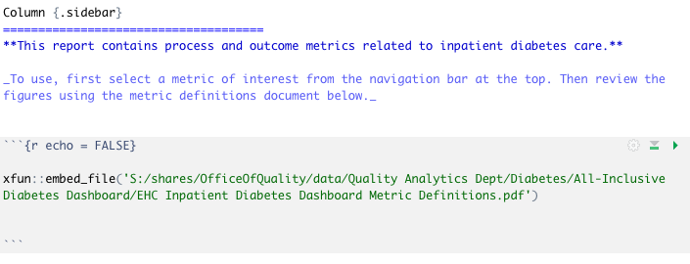
Current Projects
Setup as flexdashboard
Global sidebar with embedded definitions pdf
emoryhealthcare.org
Notes:
Global burden: there were an estimated 422 million (~9%) adults worldwide living with diabetes in 2014.
At Emory Healthcare, between 20-30% of inpatient admissions each month are diabetics requiring comprehensive care for both the chronic disease and any acute problem resulting in the hospitalization
Goal is to understand and improve care now to reduce burden later

Slide 12
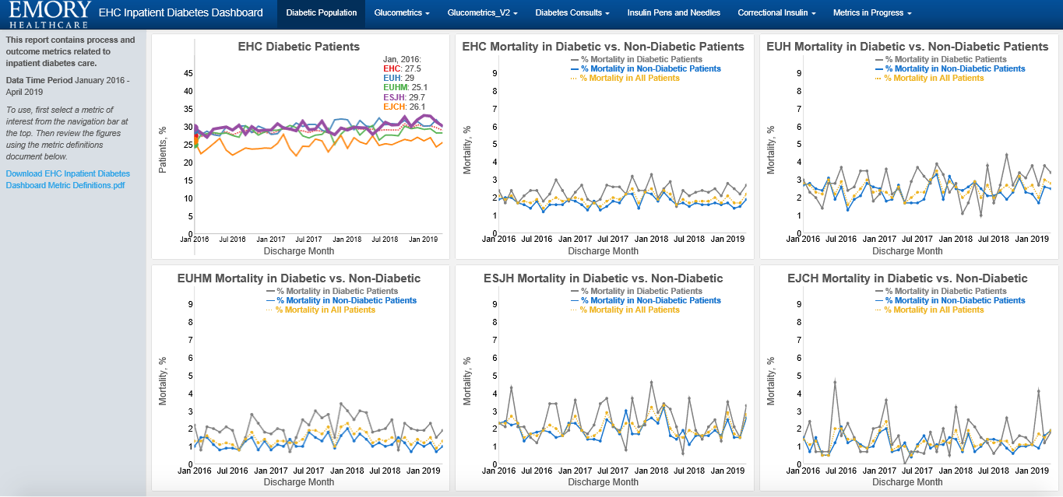
emoryhealthcare.org
Notes:
System-level reporting for our 4 main hospitals

Slide 13
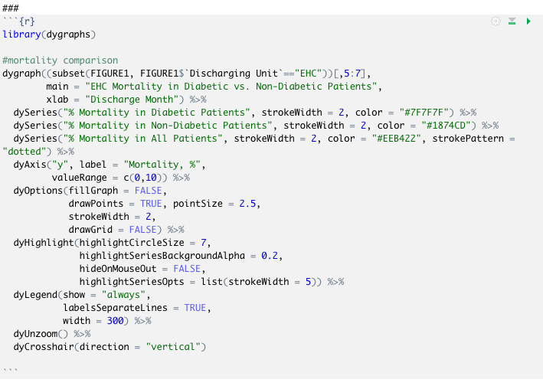
emoryhealthcare.org
Notes:
System-level reporting for our 4 main hospitals

Slide 14
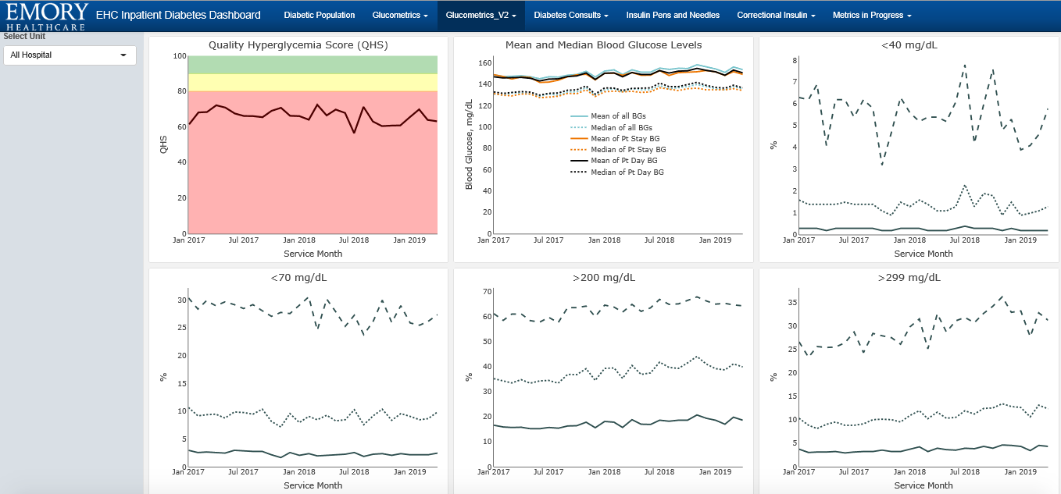
emoryhealthcare.org
Notes:
System-level reporting for our 4 main hospitals

Slide 15
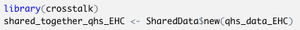
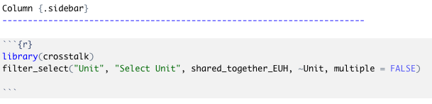
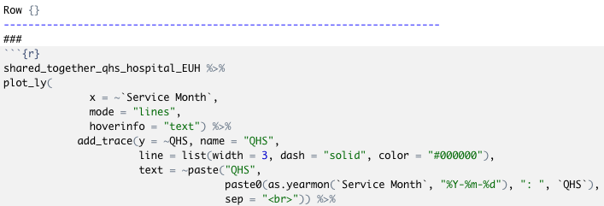
emoryhealthcare.org
Notes:
System-level reporting for our 4 main hospitals

Slide 16
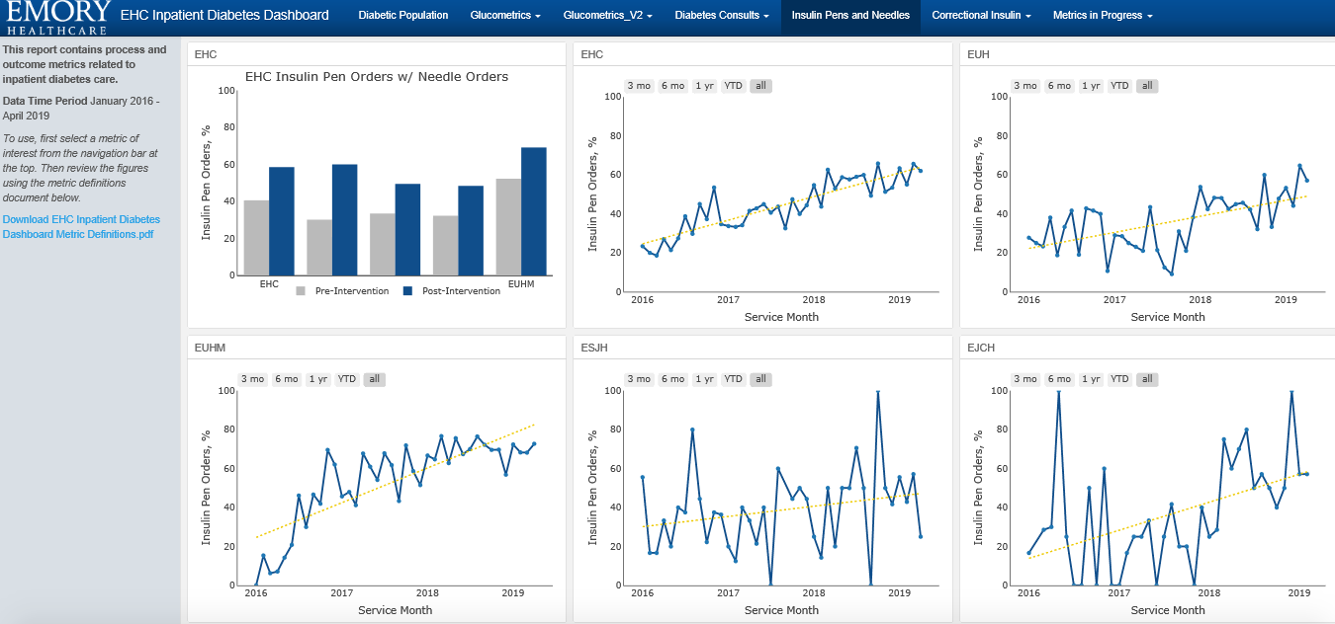
emoryhealthcare.org
Notes:
System-level reporting for our 4 main hospitals

Slide 17
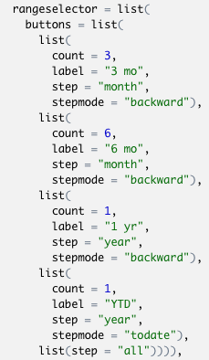
emoryhealthcare.org
Notes:
System-level reporting for our 4 main hospitals

Slide 18
Case Study: Reducing Correctional Insulin (Sliding Scale Insulin) Administration Errors
Correctional insulin is insulin dosing meant to correct or lower high blood sugar before meals.
Calculated using a “correction factor” determined by the ordering provider.
Nursing must interpret the order and administer the correct dose based on the last blood glucose result
Example:
(BG-100)/40 = # units for BG ≥ 180 mg/dL, Subcutan AND round up to nearest whole unit
Questions:
How often are correctional insulin doses accurate? How often are we underdosing? Overdosing?
Do we have a standard system of dosage calculation across the system?
Is our process in control?
emoryhealthcare.org
Notes:
System-level reporting for our 4 main hospitals

Slide 19



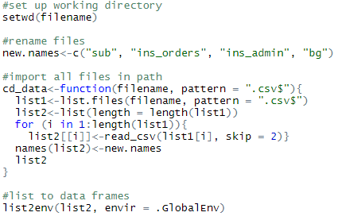
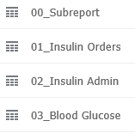
Data Import
Data Pull
Data Cleaning
Data Analysis
Data Visualization
Notes:
GOAL: Automate each step of the process

Slide 20
Data Cleaning
Data Cleaning
Data Pull
Data Analysis
Data Visualization
Patient
Correctional Insulin Order
Previous Blood Glucose
Insulin Dosage Administered
Correct Dose?
Notes:
GOAL: Automate each step of the process

Slide 21
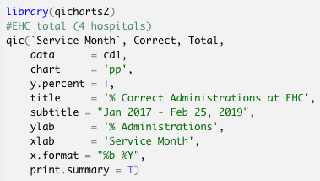
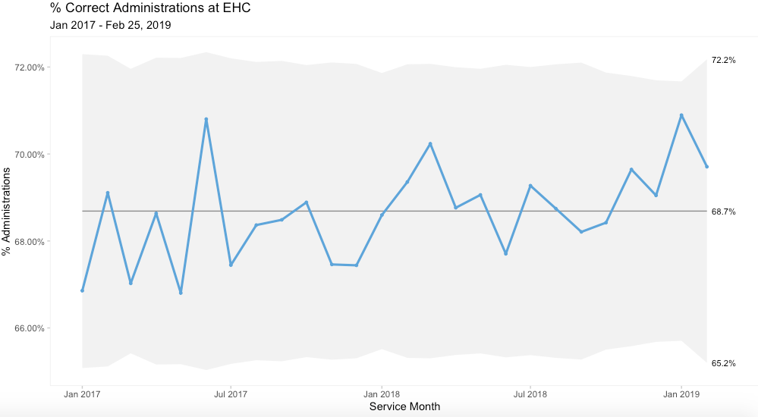
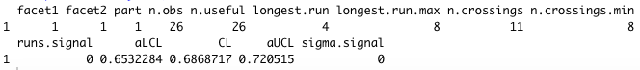
Data Analysis: Statistical Process Control (SPC)/Shewhart Charts
Line graphs showing measures over time
Center: mean
Control limits: natural variation limits inherent in the process (3σ limits)
Common cause variation
Process is in control!
emoryhealthcare.org
Notes:
System-level reporting for our 4 main hospitals

Slide 22
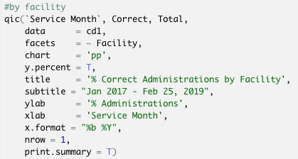
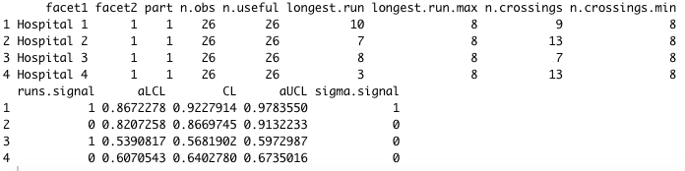
Notes:
System-level reporting for our 4 main hospitals

Slide 23
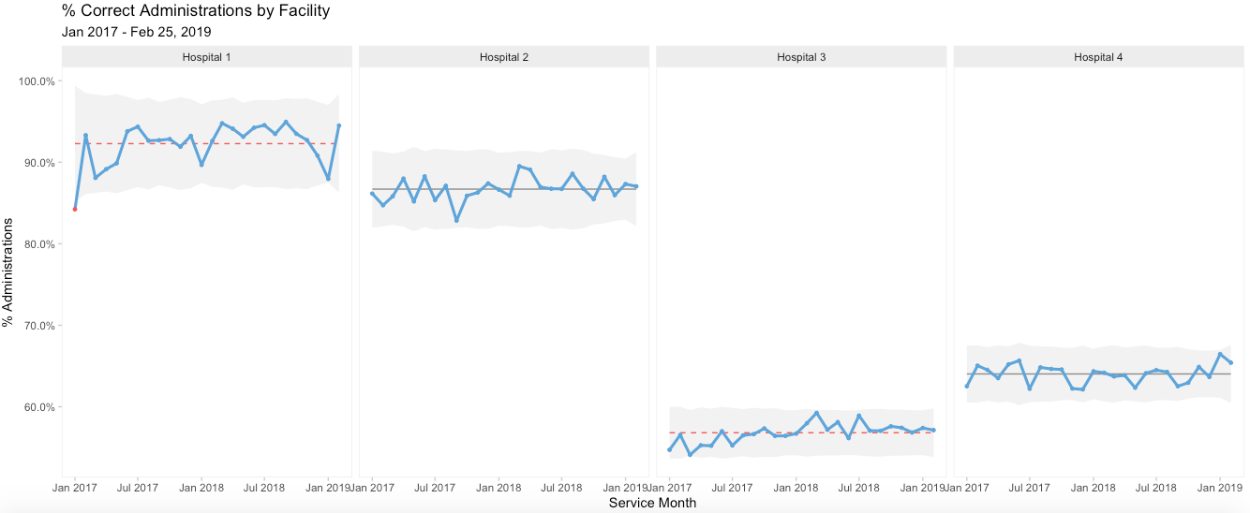
Notes:
System-level reporting for our 4 main hospitals

Slide 24
Table-based system
Formula-based system
Formula-based system
Formula-based system
Notes:
System-level reporting for our 4 main hospitals

Slide 25

Table-based system
Formula-based system
Formula-based system
Formula-based system
Notes:
System-level reporting for our 4 main hospitals

Slide 26
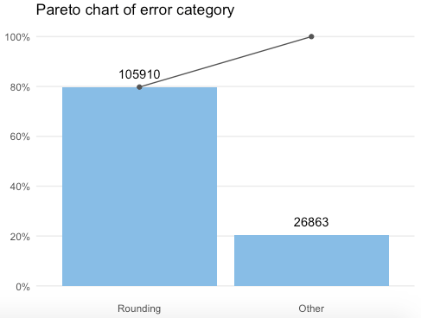
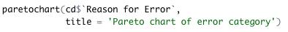
Data Analysis: Pareto Chart
emoryhealthcare.org
Notes:
System-level reporting for our 4 main hospitals

Slide 27
emoryhealthcare.org
Notes:
System-level reporting for our 4 main hospitals

Slide 28
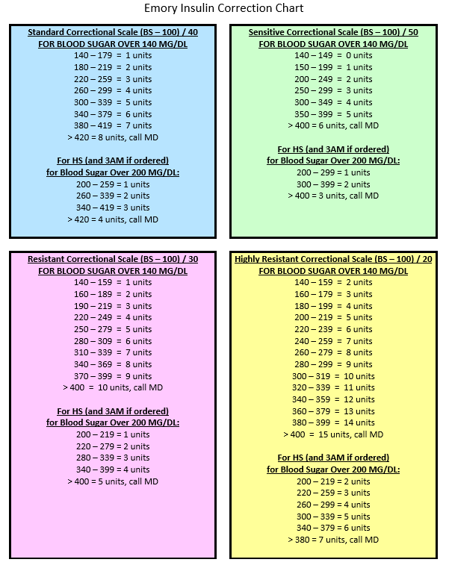
Process Change
Using this data, we got buy-in from leadership to change a process that had been around for decades
emoryhealthcare.org
Notes:
System-level reporting for our 4 main hospitals

Slide 29
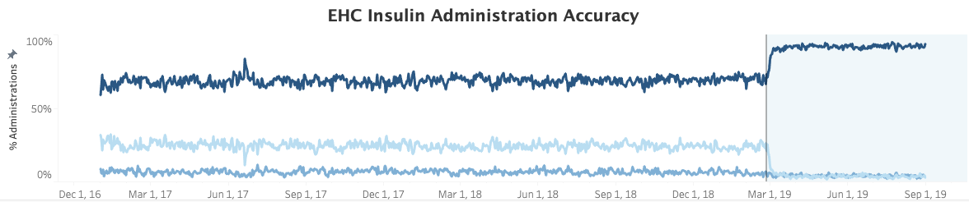
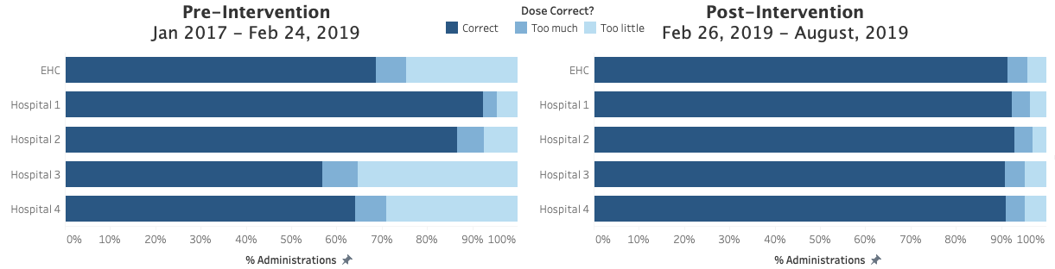
emoryhealthcare.org

Slide 30
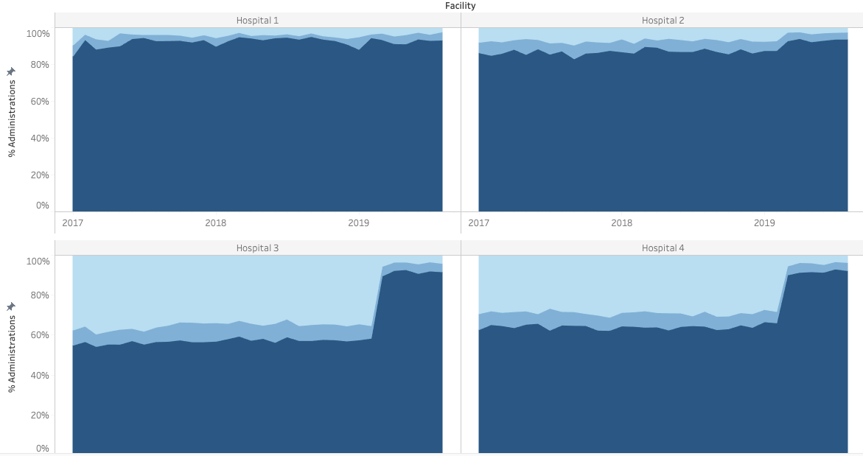

Slide 31
References
Carson Sievert (2018) plotly for R. https://plotly-r.com
Dan Vanderkam, JJ Allaire, Jonathan Owen, Daniel Gromer and Benoit Thieurmel (2018).
dygraphs: Interface to 'Dygraphs' Interactive Time Series Charting Library. R package
version 1.1.1.6. https://CRAN.R-project.org/package=dygraphs
Hadley Wickham (2017). tidyverse: Easily Install and Load the 'Tidyverse'. R package
version 1.2.1. https://CRAN.R-project.org/package=tidyverse
Jacob Anhoej (2019). qicharts2: Quality Improvement Charts. R package version 0.6.0.
https://CRAN.R-project.org/package=qicharts2
JJ Allaire and Yihui Xie and Jonathan McPherson and Javier Luraschi and Kevin Ushey and
Aron Atkins and Hadley Wickham and Joe Cheng and Winston Chang and Richard Iannone
(2019). rmarkdown: Dynamic Documents for R. R package version 1.14. URL
https://rmarkdown.rstudio.com.
McDonald KM, Sundaram V, Bravata DM, et al. Closing the Quality Gap: A Critical Analysis of Quality Improvement Strategies (Vol. 7: Care Coordination). Rockville (MD): Agency for Healthcare Research and Quality (US); 2007 Jun. (Technical Reviews, No. 9.7.) 5, Conceptual Frameworks and Their Application to Evaluating Care Coordination Interventions. Available from: https://www.ncbi.nlm.nih.gov/books/NBK44008/
Yihui Xie and J.J. Allaire and Garrett Grolemund (2018). R Markdown: The Definitive
Guide. Chapman and Hall/CRC. ISBN 9781138359338. URL https://bookdown.org/yihui/rmarkdown.
emoryhealthcare.org
Notes:
System-level reporting for our 4 main hospitals

Slide 32
Thank you!
shanza.ashraf@emoryhealthcare.org
emoryhealthcare.org

